Slide 1



BASICS OF COMBINATORICS, SETS, AND BINARY LOGIC

Slide 2

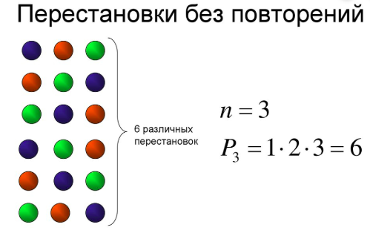
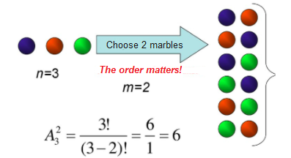
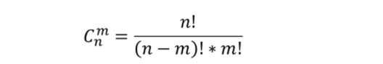
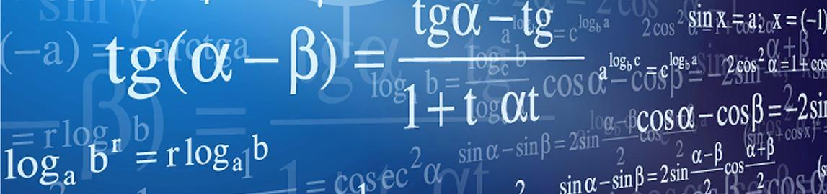
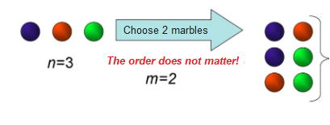
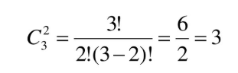
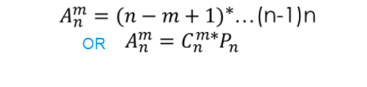
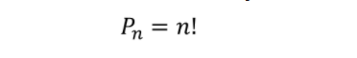
Combinatorics
PERMUTATION, COMBINATION, AND VARIATION (W/O REPETITION)
Permutation
without repetition
Combination
without repetition
Variation
without repetition
How many ways are there to select m items out of a collection of n items
6 possibilities
Six different options
3 combinations
How many ways of selecting m items (from n items) if we allowed to change the order?
How many ways are there to sort n different objects

Slide 3

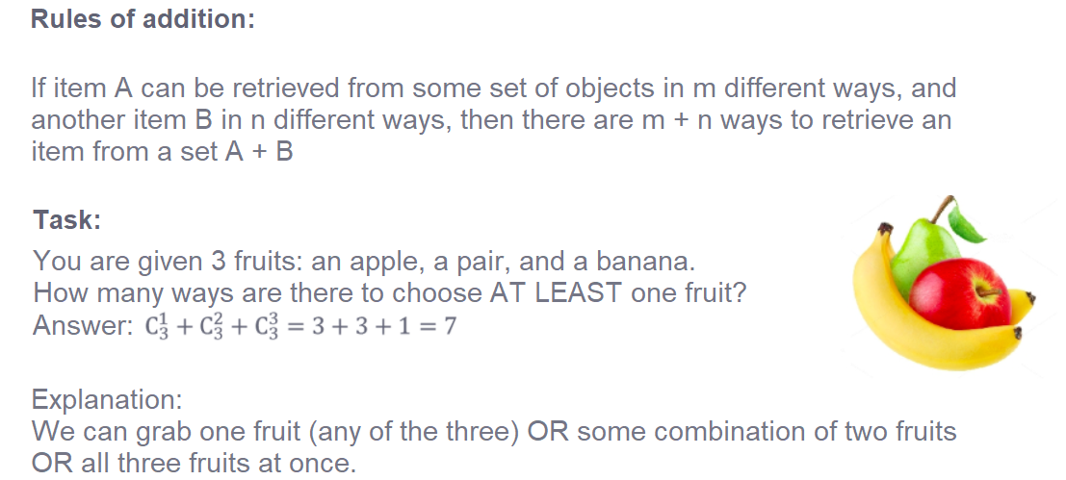
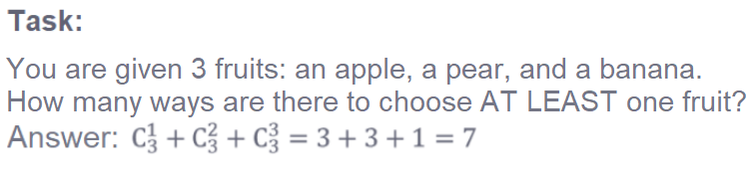
COMBINATORICS
ADDITION AND MULTIPLICATION

Slide 4
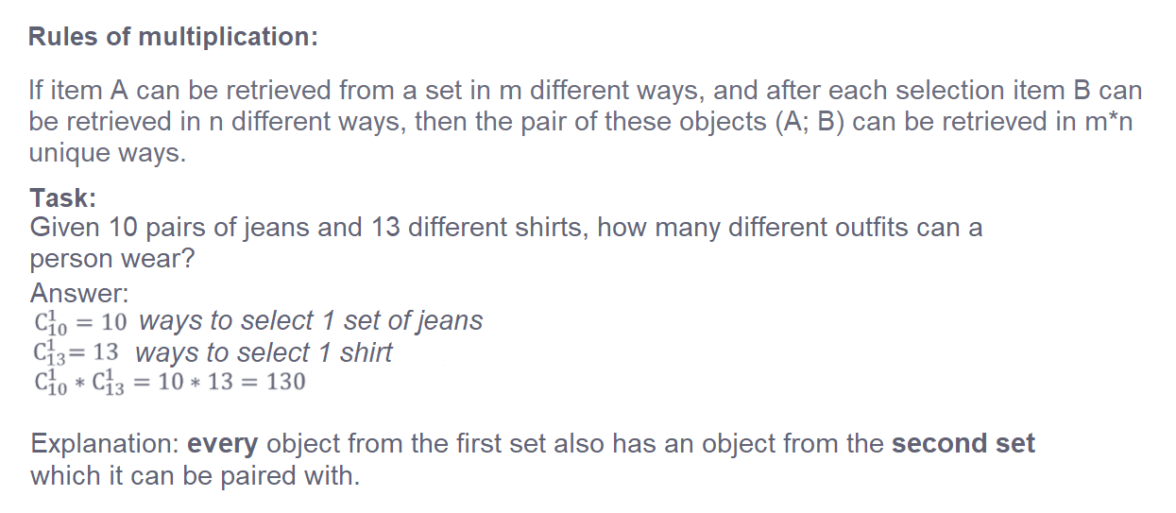
COMBINATORICS
ADDITION AND MULTIPLICATION

Slide 5
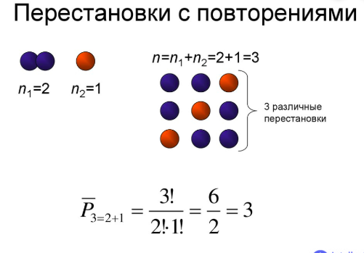
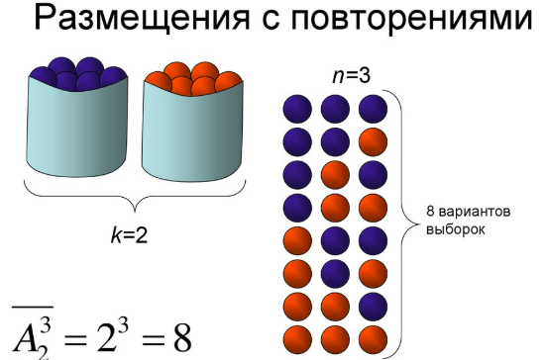
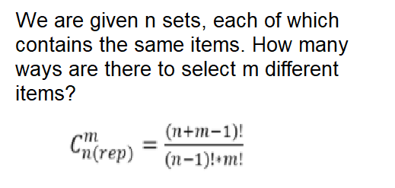

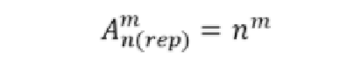
Combinatorics
PERMUTATION, COMBINATION, AND VARIATION (WITH REPETITION)
Permutation
with repetition
Combination
with repetition
Variation with
repetition
We are given n sets, each of which contains the same items. How many ways are there to select m different items?
3 possible
permutations
8 possible
choices
The number of ways to sort n items, among which the first item is repeated n_1 times, the second item is repeated n_2 times…, the nth item is repeated n_k times
Given a set consisting of n items and the condition that each item can be chosen more than once, how many ways are there to select m items from that set, if the order of choice matters

Slide 6


BASICS OF
COMBINATORICS,
SETS, AND BINARY
LOGIC
Sets

Slide 7

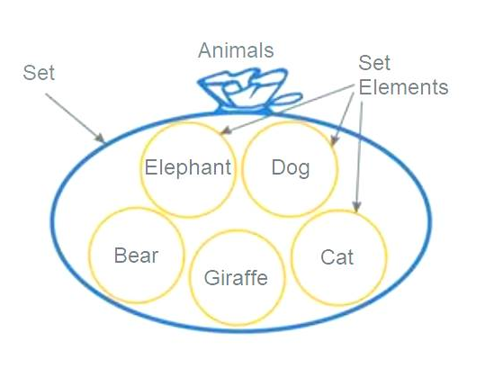
Examples of Sets:
Set of letters from the English alphabet
Set of natural numbers
SETS – a collection of any objects, which are interpreted as a whole
(ie. sorted based on any categories, criteria, and circumstances).
A = {a, b, c, …,x, y, z}
S E T S
Notation:
b
- letter ‘b’ belongs to set A
- ‘beta’ doesn’t belong to set A
- ‘5’ belongs to set N
- ‘5,5’ doesn’t belong to set N

Slide 8
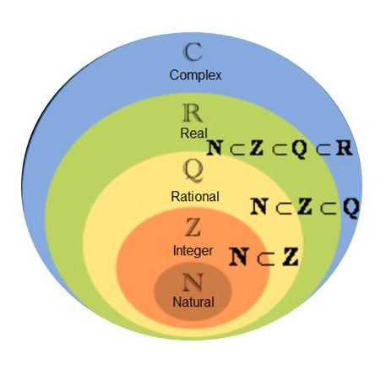


Examples of sets:
Set of integer numbers
Set of rational numbers
Set of real numbers
Subsets – Set X is a subset of set Y if every element in X also belongs to set Y.
S E T S
Notation:
Set G is a subset of set А

Slide 9

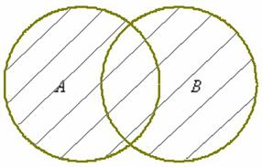
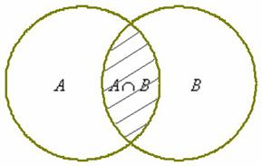
OPERATIONS
INVOLVING SETS
Intersection (AND)
An intersection of sets A and B
is another set , each of which is present both in set A and in set B.
2. Union (OR)
a UNION of sets A and B
is another set , each of which is present in either set A OR in set B..

Slide 10
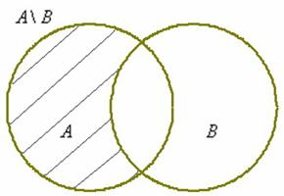
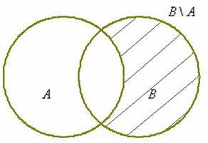
OPERATIONS
INVOLVING SETS
3. Difference
The difference between sets A and B is another set , in which each element belongs to set A and does not belong to set B .

Slide 11


CARDINALITY OF A SET
Cardinality of a set - the size of a set, ie. the number of elements contained within a set.
Examples:
Cardinality of the set of English alphabet letters is 26
Cardinality of the set of students is six.
Identities:
The cardinality of an empty set is 0
The cardinality of numbers from 0 to N (inclusively) is N + 1
The cardinality of two sets containing the same elements is identical.
*We can also compare the cardinality of infinite sets
M(N) < M(Z) – The cardinality of natural numbers is less than the cardinality of integer values, BUT the cardinality of positive integer values is EQUAL TO the cardinality of natural numbers..
Any non-finite set has a cardinality of infinity, even if we take some non-zero fraction of the set (ie. the set of real numbers R)

Slide 12


Thank you
for your attention

